Slide 1
Team Name : Super Mario Project Title : Visual History of Nobel Prize Winners Member 1 : Youhanna Adel == 37-14779 Member 2 : Nader Waguih == 37-6772 Member 3 : Bishoy Raafat == 37-15522 Member 4 : Danial Malak == 37-2220
CSEN1095 : Data engineering

Slide 2
Work Distribution:
1) Data Cleaning:
Bishoy Raafat
Nader Waguih
-Removing Null Values
-Removing False Data

Slide 3
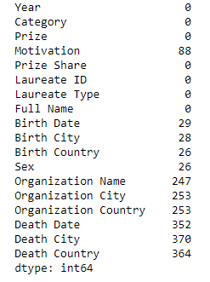
Null Values Count

Slide 4
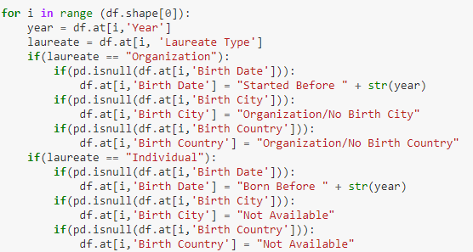
Approach To Remove The Null Values

Slide 5
Work Distribution:
2) Questions & Visualizations:
Youhanna Adel
Danial Malak
-What does the dataset tell us ?
-What are the most important visualizations ?

Slide 6
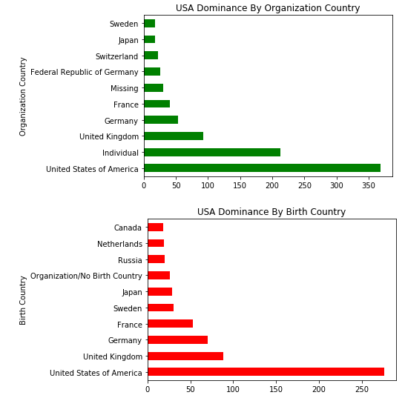
USA Dominance

Slide 7
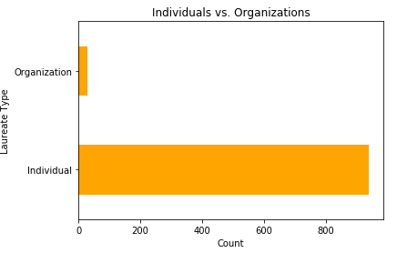
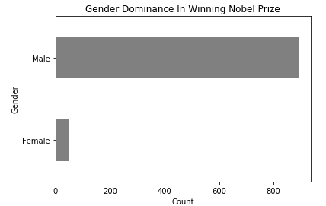
Male Vs. Female Individuals Vs. Organizations

Slide 8

Average age for winning a Nobel Prize ? Youngest And Oldest Winners ?

Slide 9
Thank You

